Slide 1


“Event Management System”
Sarvajanik Education Society
Sarvajanik College of Engineering and Technology, Surat
Master of Computer Application
Academic Year: 2023-24
Semester: 2
A Project On
Under the Guidance of
Prof. Jayana Ahuja
Presented By
Rudresh Raval - ET23MTCA119
Jemish Vaghasiya - ET23MTCA137
Darshan Bhatt – ET23MTCA071

Slide 2
Table of Contents
SR. No. | Contents
1. | Abstract
2. | Overview
3. | Key Features
4. | Software/Hardware Requirements
5. | Advantages and Disadvantages
6. | Module of System
7. | Screenshots
8. | References

Slide 3
Introduction
Event Management System is a place where user can book event ticket of his/her desired event and admin can add events and show on the site, particularly on the homepage.
There are dashboards available for admin and organizer role where admin and organizer can update data related to events and participants.

Slide 4
Abstract
The system allows users to book tickets for events and enables admin to manage events, venues, and user data efficiently. It provides secure login, browsing of events, ticket booking, and payment gateway integration.
The system gives user-friendly environment for users to book tickets in upcoming events and current events showing on homepage of the website.

Slide 5
Overview
The Online Event Management System is designed to streamline the process of event management. Users can browse events, view details, and book tickets, while administrators can add events, manage bookings, and handle payments through a secure platform.

Slide 6
Key Features
1. User Registration and Secure Login
2. Event Browsing and Details
3. Showtime and Ticket Booking
4. Admin Dashboard for Event Management
5. Secure Payment Gateway Integration
6. Data Security and HTTPS Protocol

Slide 7
Software/Hardware Requirements
User Side Requirements:
Hardware: RAM – 8 GB, Processor – Intel i3, Hard Disk – 128 GB
Software: OS – Windows 10, Browser – Chrome/Edge
Admin Side Requirements:
Hardware: RAM – 8 GB, Processor – Intel i3, Hard Disk – 128 GB
Software: Platform – PHP Laravel, Database – MySQL, Editor: VS Code

Slide 8
Advantages and Disadvantages
Advantages:
1. Facility for Event Ticket Booking
2. Booking from Anytime and Anywhere
3. Upcoming Event Details
4. Event Details with Images
Disadvantages:
1. Internet Handling Charges
2. Admin can only view user
3. No Payment Success Notification for Users

Slide 9
Module of System
1. User Interface (UI)
2. Database Management System (DBMS)
3. Authentication and Authorization
4. Payment Gateway Integration
5. Event and Seat Management

Slide 10
UseCase Diagram

Slide 11
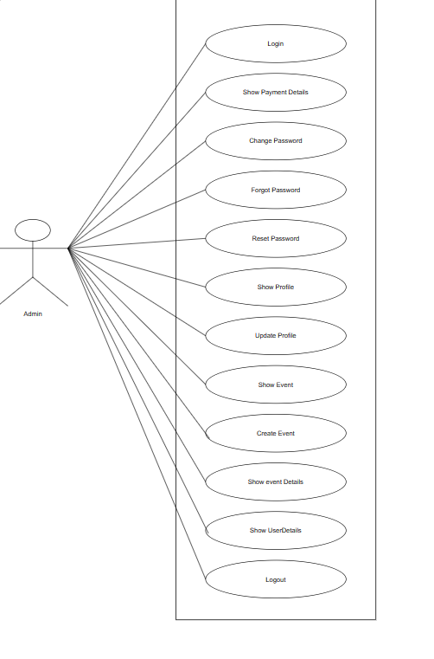
UseCase diagram for admin

Slide 12
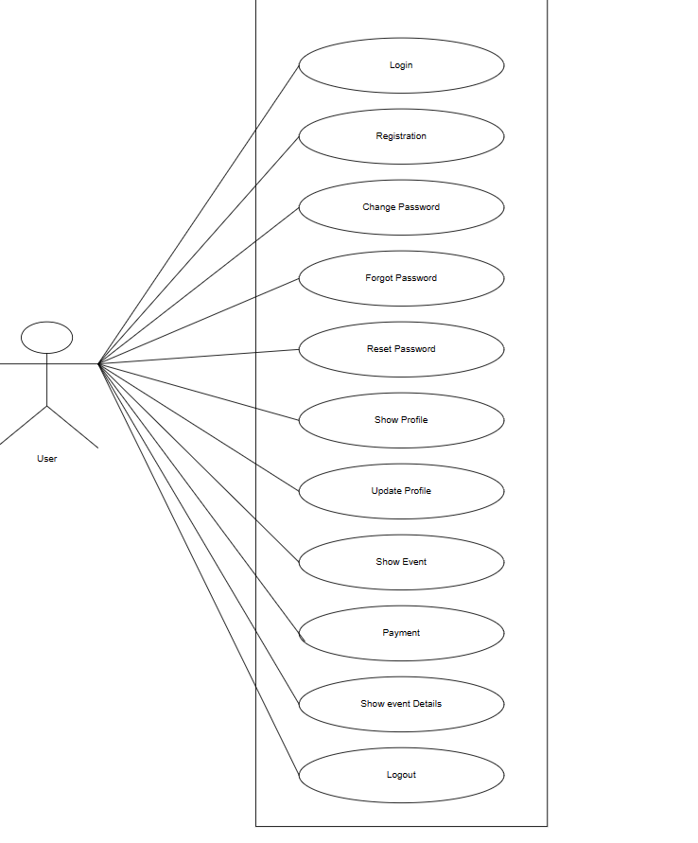
UseCase diagram for user

Slide 13
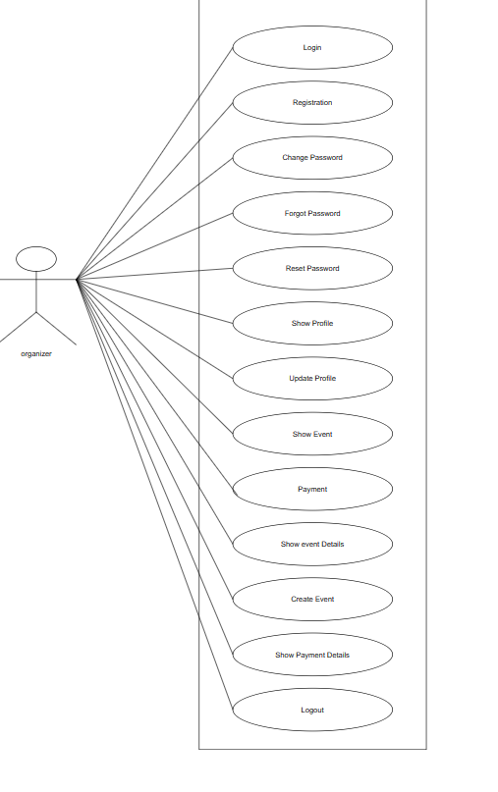
UseCase diagram for organizer

Slide 14
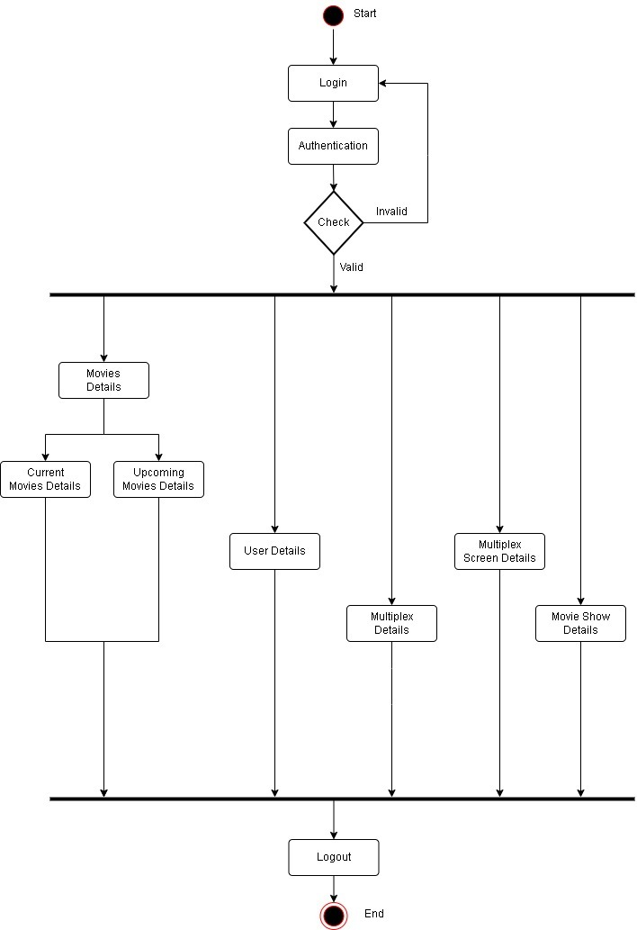
Activity Diagram for Admin

Slide 15
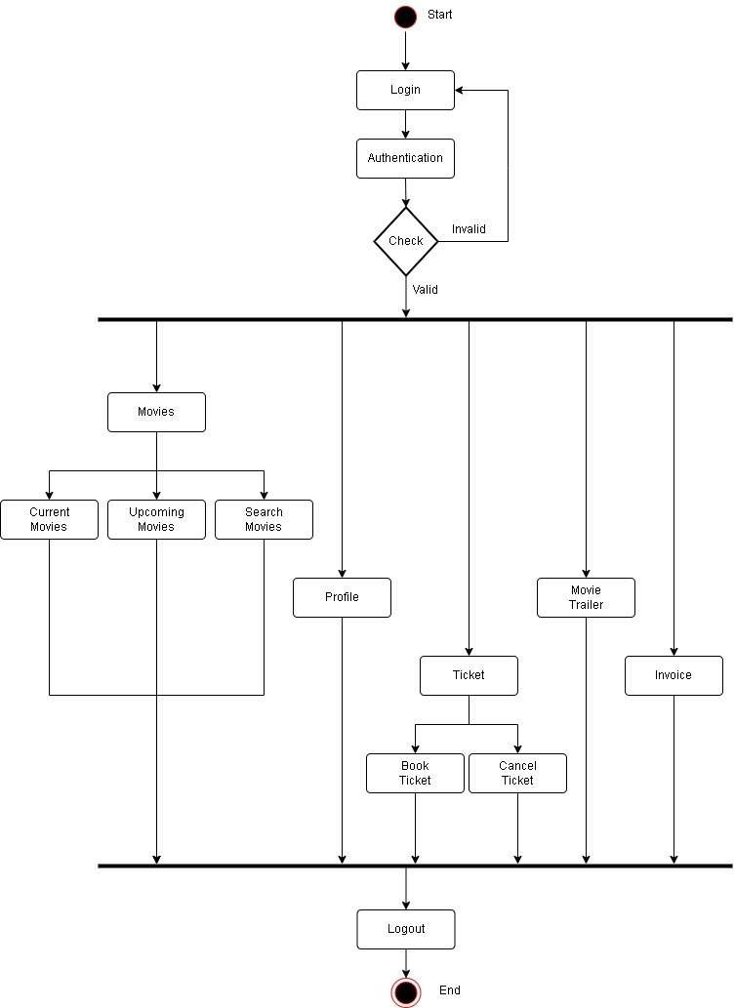
Activity Diagram for User

Slide 16
Screenshots

Slide 17
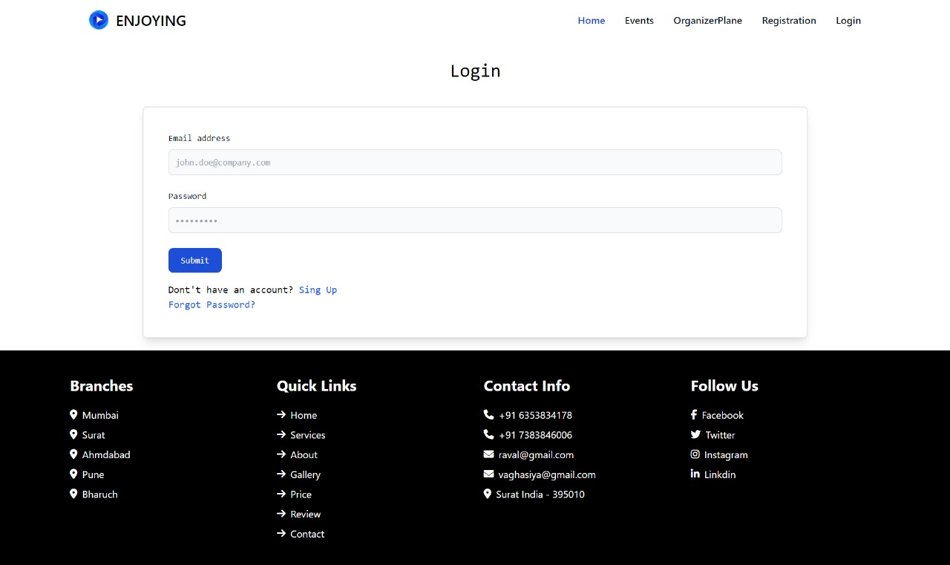
Figure 1 : Login Page

Slide 18
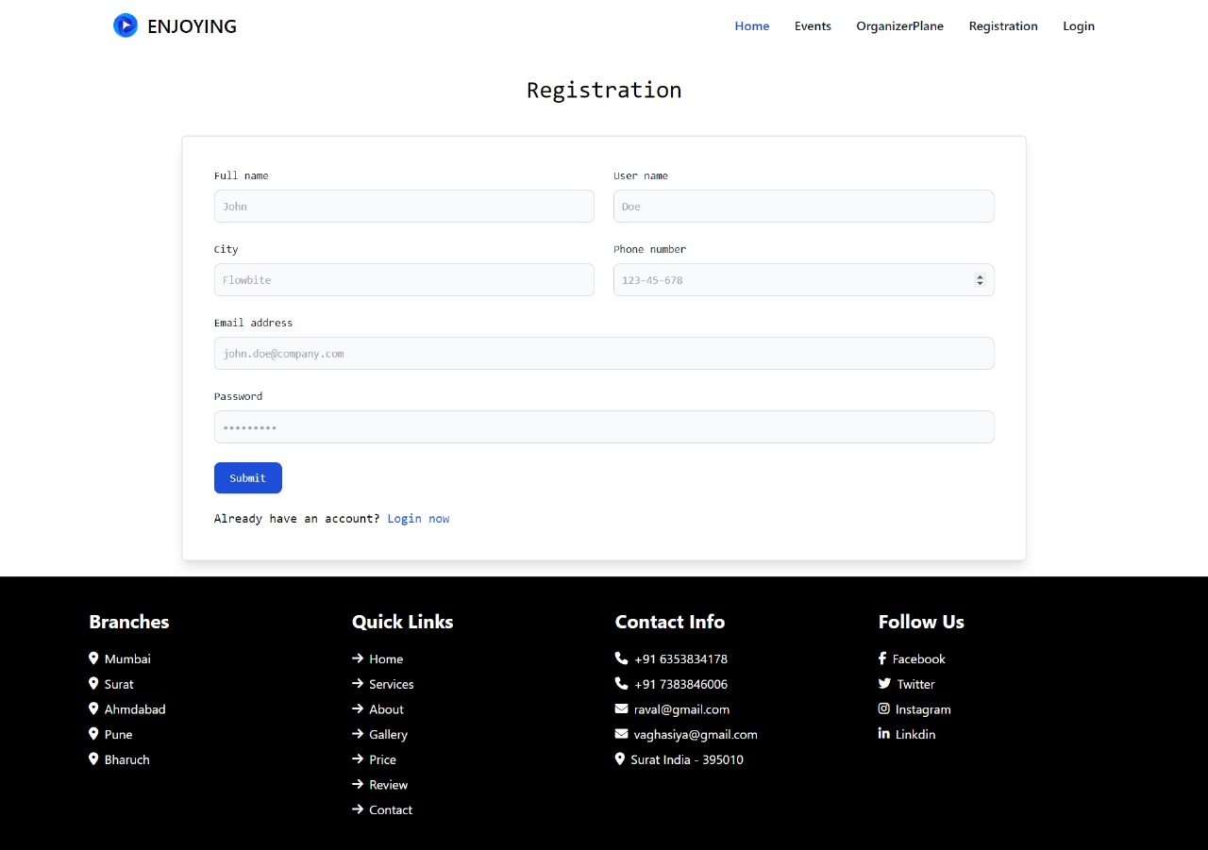
Figure 2 : Registration Page

Slide 19
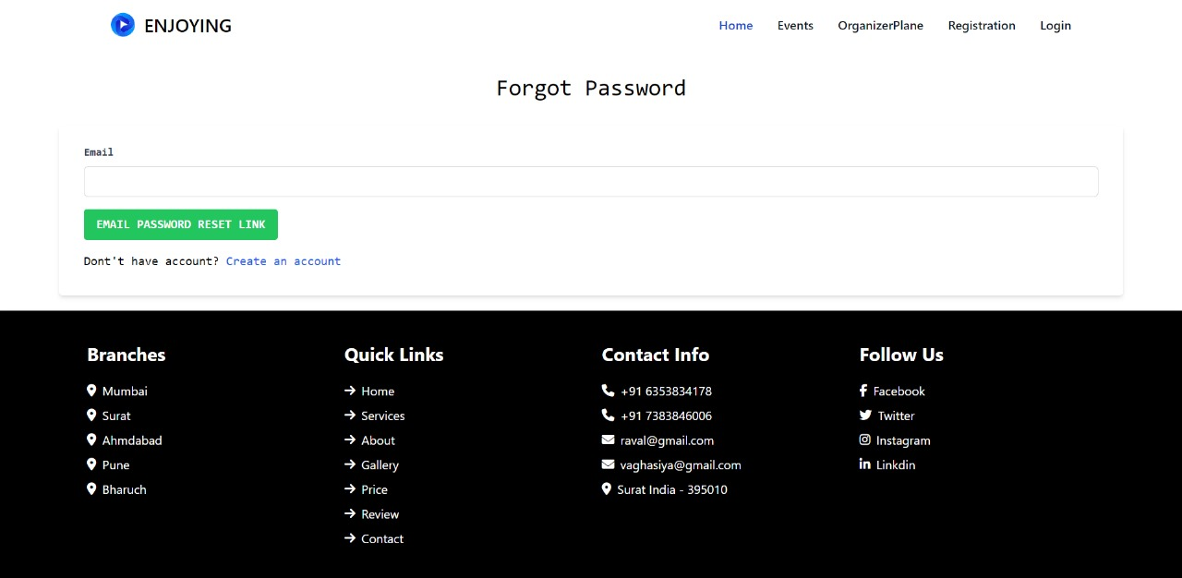
Figure 3 : Forgot Password Page

Slide 20
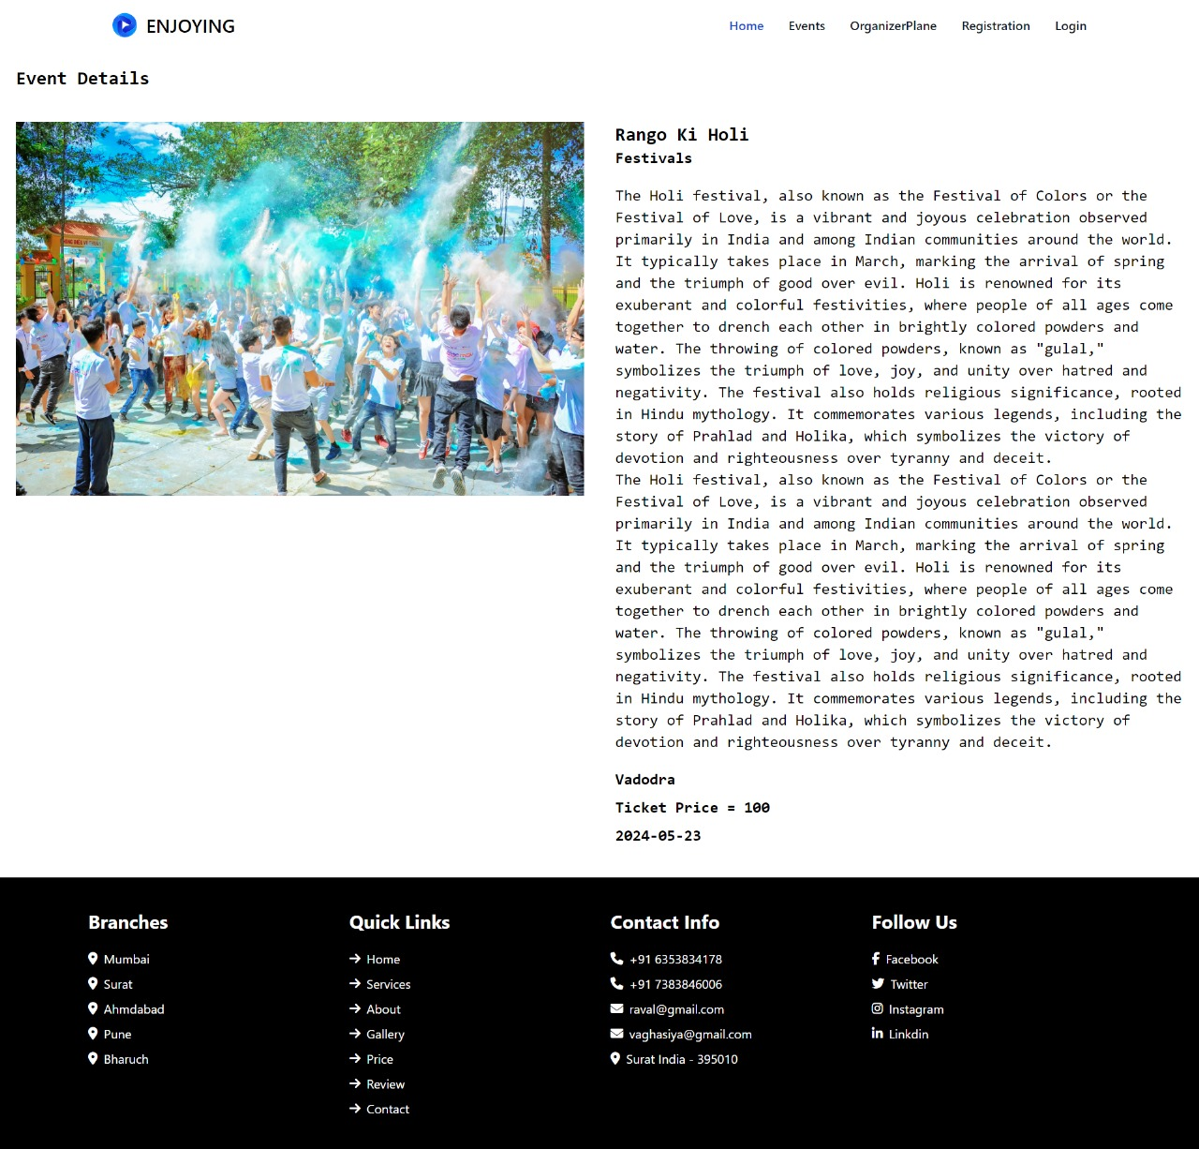
Figure 4 : Event Detail Page

Slide 21
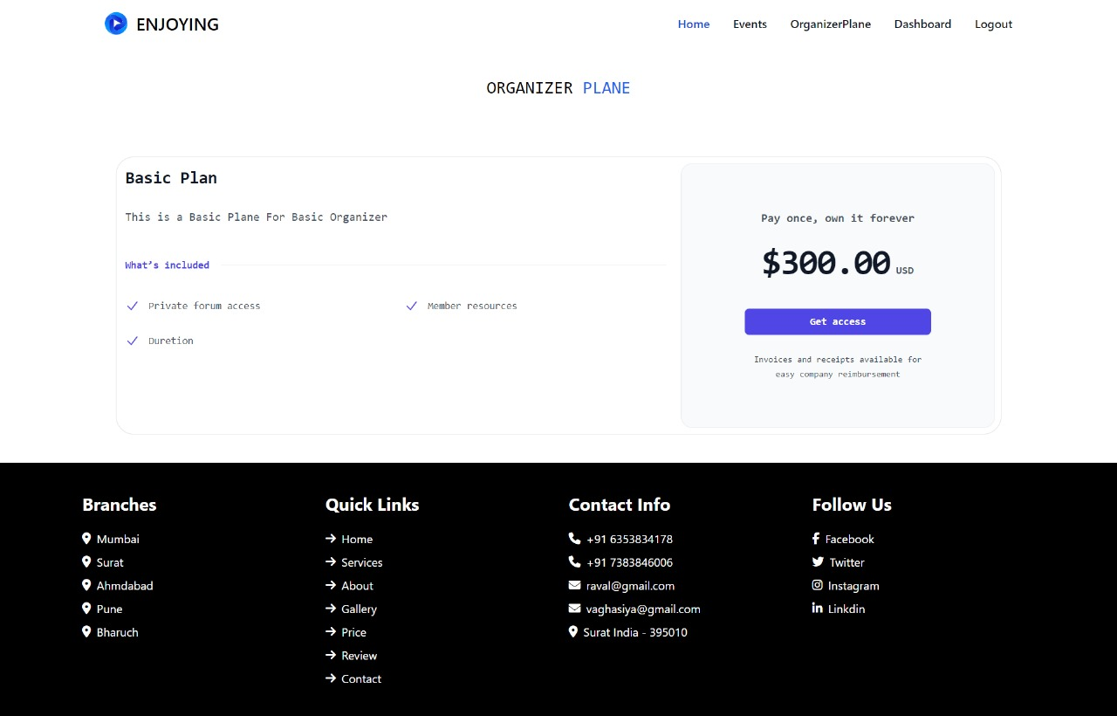
Figure 5 : Payment Plan Detail Page

Slide 22
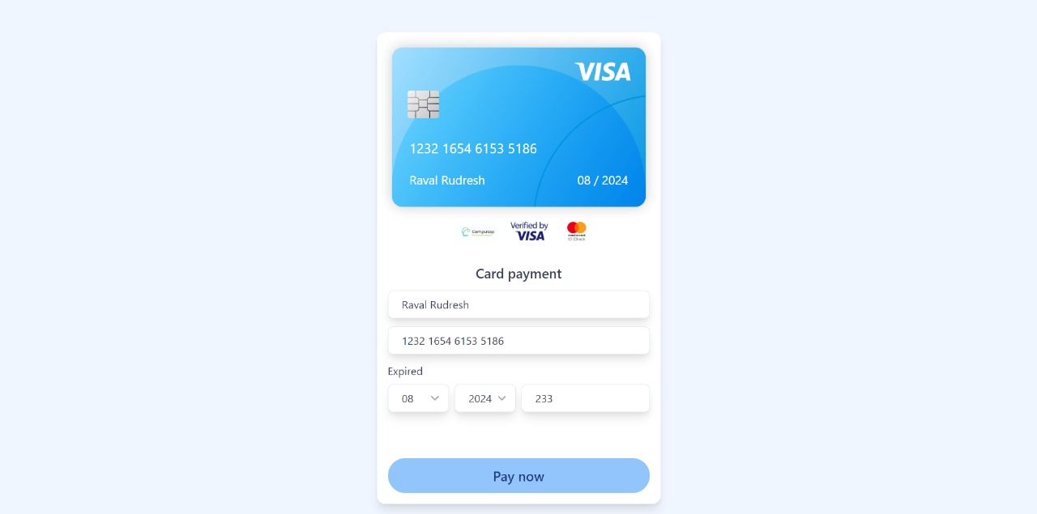
Figure 6 : Payment Page

Slide 23
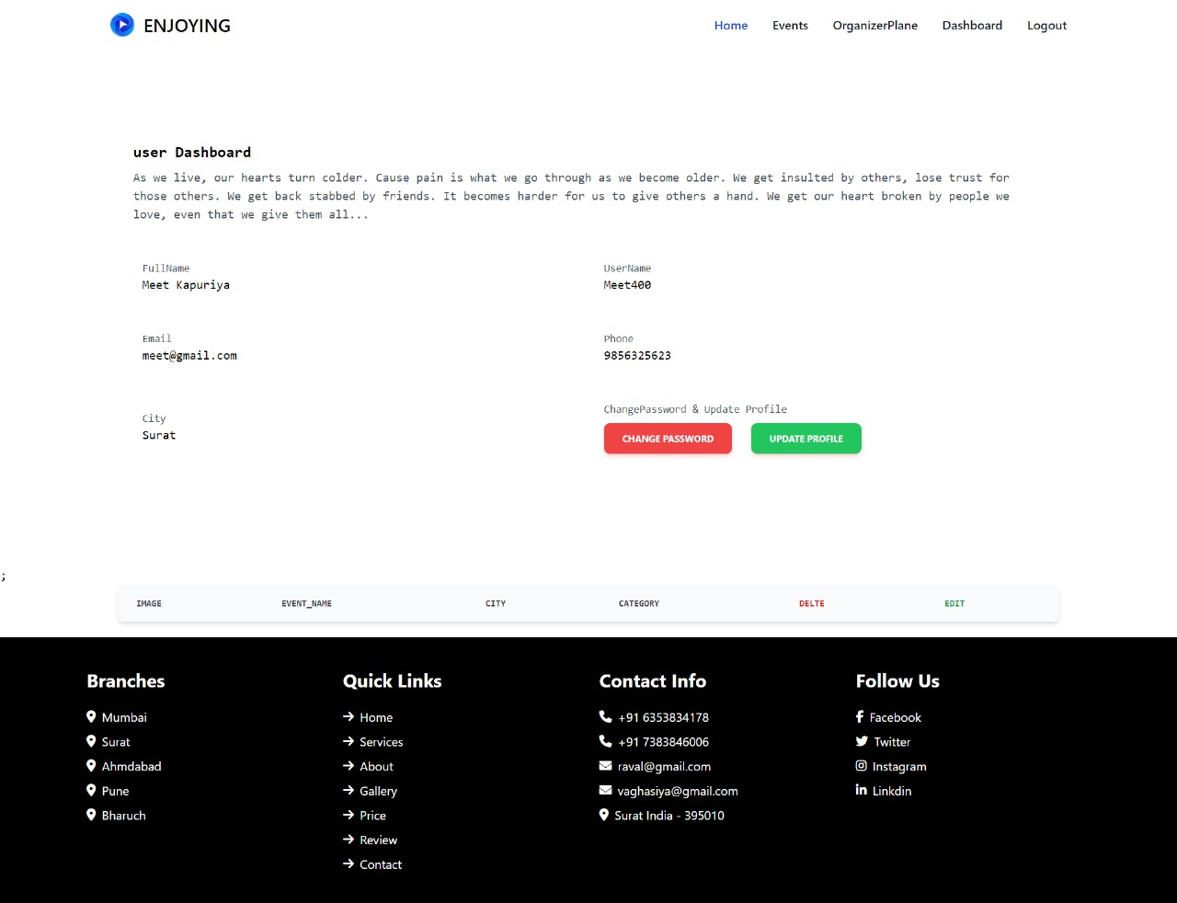
Figure 7 : User(Organizer) Dashboard Page

Slide 24
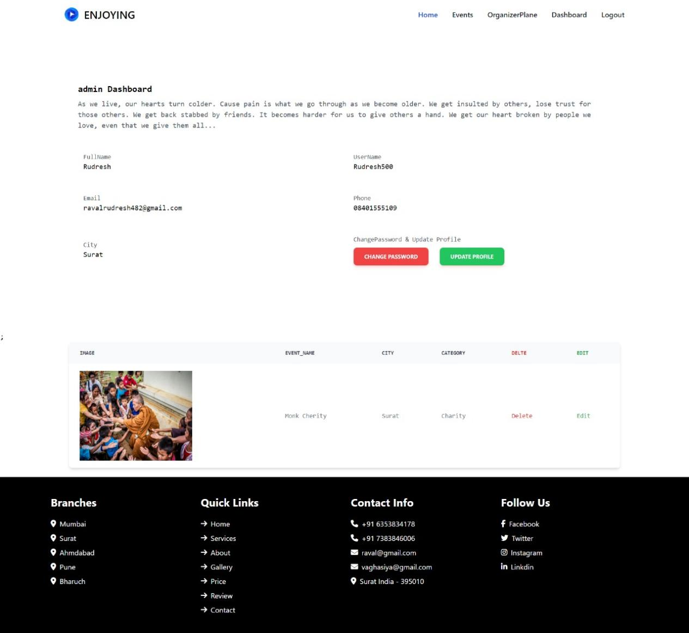
Figure 7 : Admin Dashboard Page

Slide 25
Conclusion and Future Enhancement
This Event Management System is a comprehensive solution tailored for efficient event planning and participation. By accommodating different roles with specific access and functionalities, it offers flexibility and control to organizers and admins while providing an engaging platform for users. The system's secure, scalable, and user-friendly design ensures that it meets the needs of modern event management, making it an invaluable tool for successful event planning and execution.
We propose enhancing our Event Management website with a revamped UI/UX, a user feedback system, detailed event analytics, and automated notifications. Additionally, we'll integrate multiple payment options, offer subscription plans, and upgrade admin tools with advanced user management and audit logs to improve user experience and streamline event management.

Slide 26
References
  Laravel Documentation: https://laravel.com/docs/11.x/readme
  Diagrams: www.drawio.com
  Agile User Story: https://airfocus.com/blog/how-to-write-perfect-user-stories/
  Agile Jira Software: https://team.atlassian.com/your-work

